Slide 1

TCP and OSI Communication Model
Associate Professor
Department of Computer Science and Engineering

Slide 2
Session Objectives
After completion of the session you will be able to understand
Layered model of communication
OSI model of communication
Working of each layer in OSI
TCP/IP model of communication
Comparison of OSI and TCP/IP model

Slide 3

Introduction
The Layering Principle of Communication (illustrated in adjacent figure).
The three entities are involved Sender, Carrier, Receiver.
Carrier: Ethernet Cables, Wireless, Optical Fiber, Satellite.
Protocol: A set of rules for communication.
Hardware infrastructure for interconnection.
User Interface for communication.

Slide 4

OSI Layered Model
Introduced in 1970.
OSI Stands for Open Systems Interconnection.
An ISO standard that covers all aspects of network communications.
Its goal is the interoperability of diverse communication systems with standard communication protocols.
Here, a layer serves the layer above it and is served by the layer below it.
OSI had two major components,
  Basic Reference Model or Seven Layer model,
  A set of specific protocols.

Slide 5

Layers Interconnection in OSI Model

Slide 6

Data Exchange in OSI Model
Each Layer Description is shown in subsequent slides

Slide 7

Physical Layer
The physical layer is responsible for movements of individual bits from one hop (node) to the next.

Slide 8

Data Link Layer
The data link layer is responsible for moving frames from one hop (node) to the next.

Slide 9

Data Link Layer Hop-to-Hop Delivery

Slide 10

Network Layer
The network layer is responsible for the delivery of individual packets from the source host to the destination host.

Slide 11

Packet Delivery at Network Layer

Slide 12

Transport Layer
The transport layer is responsible for the delivery of a message from one process to another.

Slide 13

Process to Process Delivery at Transport Layer

Slide 14

Session Layer
The session layer is responsible for dialog control and synchronization.

Slide 15

Presentation Layer
The presentation layer is responsible for translation, compression, and encryption.

Slide 16

Application Layer
The application layer is responsible for providing services to the user.

Slide 17
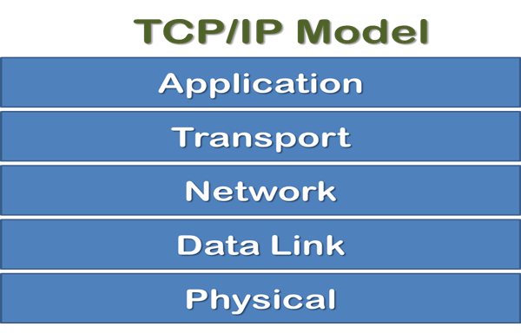
TCP/IP Communication Model
TCP/IP means Transmission Control Protocol and Internet Protocol.
It is the network model used in the current Internet architecture as well.
Developed by Department of Defence's Project Research Agency (ARPA, later DARPA) as a part of a research project of network interconnection to connect remote machines.
Protocols are set of rules which govern every possible communication over a network.

Slide 18
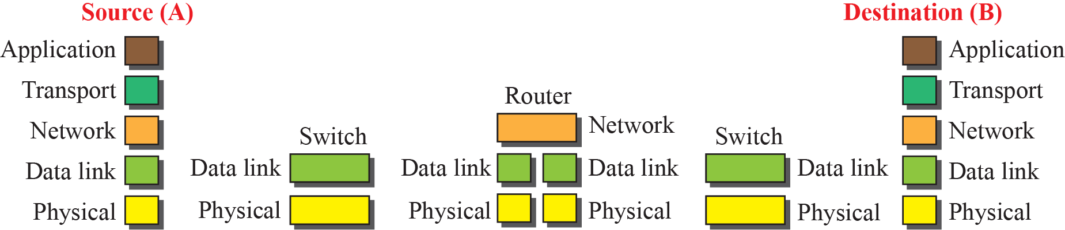
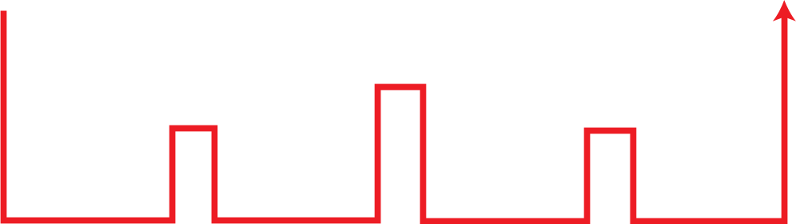
TCP/IP Communication at Data Link Layer

Slide 19
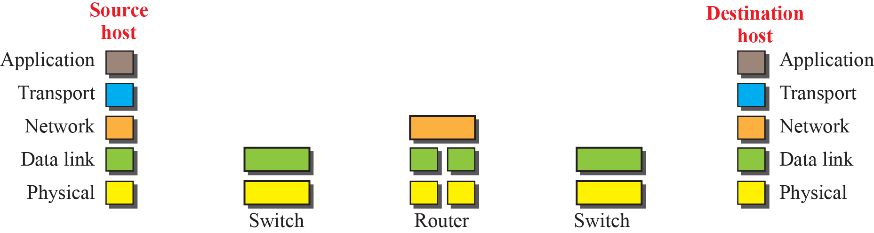
TCP/IP Communication at Network Layer

Slide 20

TCP/IP Addressing at different Layer
Notes:
Stream Control Transmission Protocol (SCTP)

Slide 21

TCP/IP Physical Addressing
07:01:02:01:2C:4B
A 6-byte (12 hexadecimal digits) physical address.

Slide 22

TCP/IP Logical Addressing
The physical addresses will change from hop to hop, but the logical addresses usually remain the same.

Slide 23

TCP/IP Port Addressing
753
A 16-bit port address represented as one single number.

Slide 24

TCP/IP and OSI Compared
Notes:
ICMP: Internet Control Message Protocol (ICMP)
IGMP: Internet Group Management Protocol (IGMP)
SCTP: Stream Control Transmission Protocol (SCTP)

Slide 25

Summary
Notes:
1.#

Slide 26
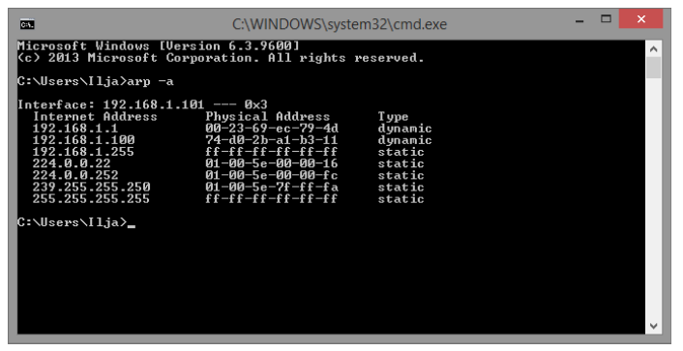
ARP Table Example
Notes:
1.#

Slide 27
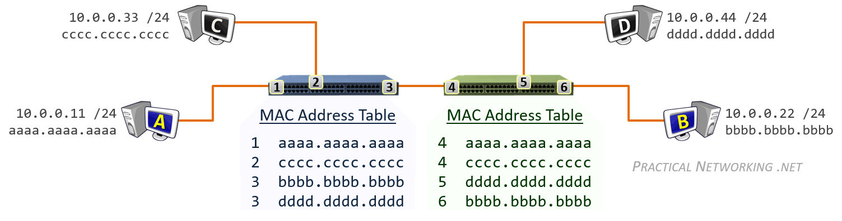
Switching Table Example
Notes:
1.#

Slide 28
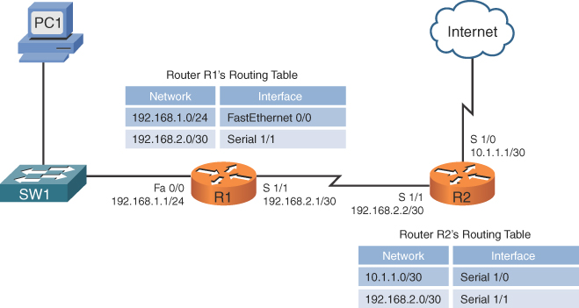
Routing Table Example
Notes:
1.#

Slide 29

Notes:
1.#

